Slide 1
Sustainability
Around the World
Data Mining
Aradhya Mathur
Ozlem Gunes
Notes:
Good Afternoon
Today I (Ozlem) and Aradhya are going to present. Our topic is Sustainability Around the World.

Slide 2


1) Problem Definition
2) Data
Data Description
EDA
3) Studies / Methods
Searching for external factors having significant effect on sustainable development
Time series analysis / model / predictions to see external factor effects
4) Conclusion
5) Future Work and References
Agenda
Notes:
Today we will be covering problem definition, data description and EDA.
After that we will talk about our methods.
Method - In this section, different methods are used to search the impacts of external factors on the environmental sustainability performance of countries, regions, and the world. These external factors consist of the components of the world economy, social inclusion, or unusual (unexpected) factors such as COVID.
We will be ending with conclusions, future work and references.

Slide 3
Problem Definition
Complex relations between the world economy, physical environment (climate change, environmental health, and ecosystem vitality) and social inclusion.
We will spot;
The environmental sustainability performance of each region and country,
The impact of external factors (Life expectancy, GDP per capita, COVID, so on) on environmental sustainability,
How much they have addressed the environmental challenges they faced in past years and how they will.
Notes:
To determine relationships between EPI and external factors like GDP per capita, Life Expectancy and GHS Index.
Analyze the impact of COVID-19 on EPI scores. Also, analyzing the post COVID-19 period.

Slide 4
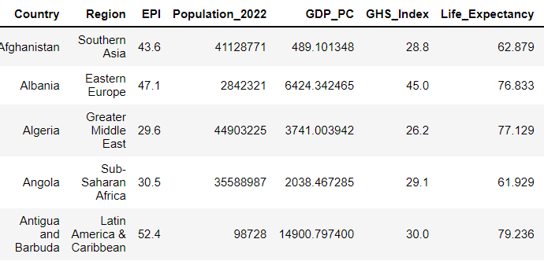
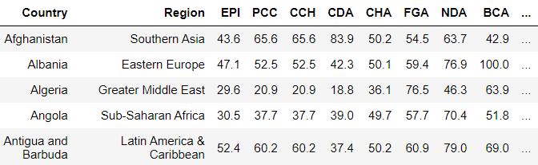
Data Description
EPI
External Factors
Environmental Performance Index
There are 57 attributes in our EPI dataset for 180 countries.
There are 15 attributes in our external factors dataset..
Notes:
We have three datasets. First dataset is about the Environmental Performance Index and is taken from NASA Sedac[1] . Second database consists of external factors like GDP, Life Expectancy.

Slide 5
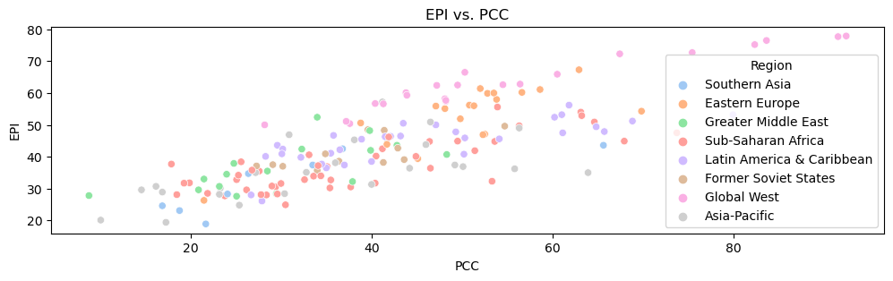
Exploratory Data Analysis
PCC refers to Climate change mitigation score.
Most of the global west countries have good EPI scores as well as PCC scores.
Notes:
Exploratory data analysis is an important step and helps in determining trends, relations and insights within attributes. We will be doing country-region based analysis, binning and frequent pattern mining to generate insights.
From this analysis we can generate insights and confirm some pre known relations between attributes. Heatmap and scatterplots are great methods to determine correlations and trends.
Most of the countries in the Global West region have good EPI scores as well as PCC scores which is observed in

Slide 6
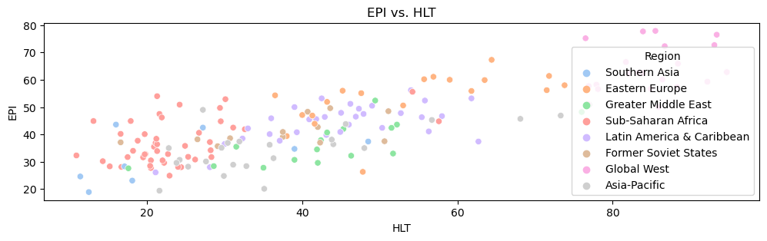
Exploratory Data Analysis
HLT refers to Environmental Health score.
Most of the global west countries have good scores while countries in Sub-Saharan African region have pretty bad scores.
Notes:
All the Global West countries have a great HLT score, followed by Eastern European countries. Countries in the Sub-Saharan African region have poor scores.

Slide 7
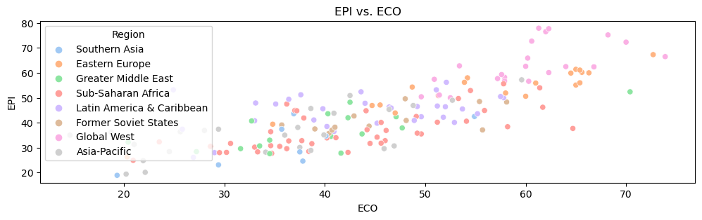
Exploratory Data Analysis
ECO refers to Ecosystem Vitality score.
Most of the countries lying in global west region and eastern Europe have great scores.
Notes:
Similar observations can be made from the above figure. Countries lying in the Global West and Eastern European region have the best ECO scores

Slide 8
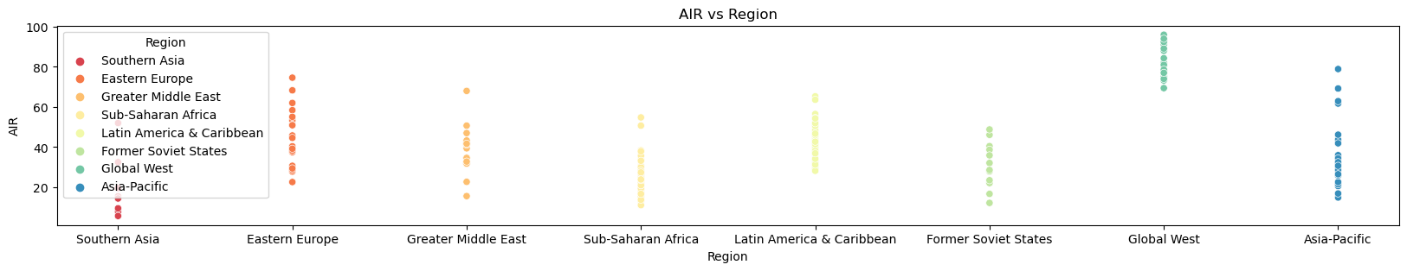
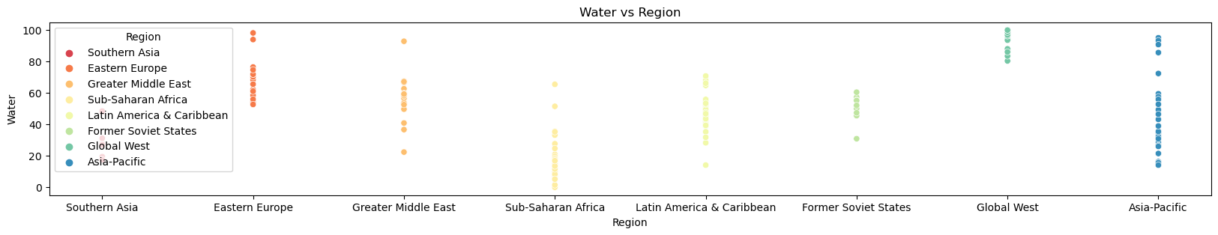
Exploratory Data Analysis
Air quality is highest in Global West region while poorest in Southern Asian countries.
Water quality is best in Global West, closely followed by Eastern Europe and Asia-Pacific regions. Sub- Saharan African region have the lowest water quality score.
Notes:
It can be inferred that countries lying in the Global West region have the best air quality scores. while countries lying in Southern Asian regions have poor scores
It can be inferred that countries lying in the Global West, Asia-Pacific and Eastern Europe regions have better water quality scores. while countries lying in Sub-Saharan African regions have poor scores

Slide 9
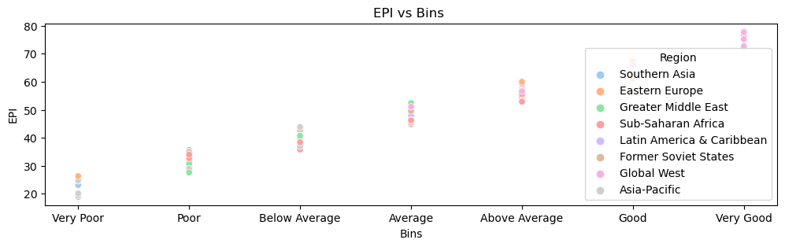
Exploratory Data Analysis
Binning
Using binning method, we have binned EPI scores of countries into 7 bins as shown.
Most of the countries in Global West and Eastern Europe have excellent EPI scores while countries in Asia-Pacific and Southern Asia have relatively worst scores..
Notes:
It can be difficult to analyze numerical variables, it can be easily done after binning as numerical variables are converted to categorical variables.
Most of the countries lying in Eastern Europe and Global West are binned in above average, good and very good bins. Also, quite a few countries in the Asia-Pacific region lie in very poor bin.

Slide 10
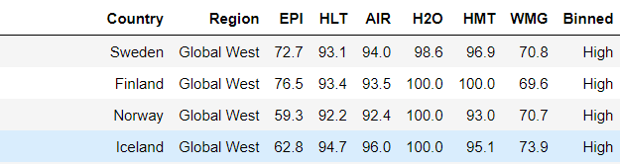
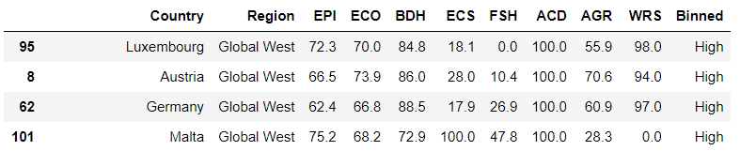
Exploratory Data Analysis
For Global West
It can observed that Iceland, Norway, Sweden and Finland have the best Environmental Health score
It can also be observed that
Luxembourg, Austria, Germany and Malta have the highest Ecosystem Vitality score.
Notes:
Countries lying in the Global West region were binned based on their HLT score. It was observed that Sweden, Finland, Norway and Iceland lie in the High HLT score bin.
Similarly, Countries lying in the Global West region were binned based on their ECO score. It was observed that Luxembourg, Austria, Germany and Malta have the best ECO score among all the countries in that region.

Slide 11
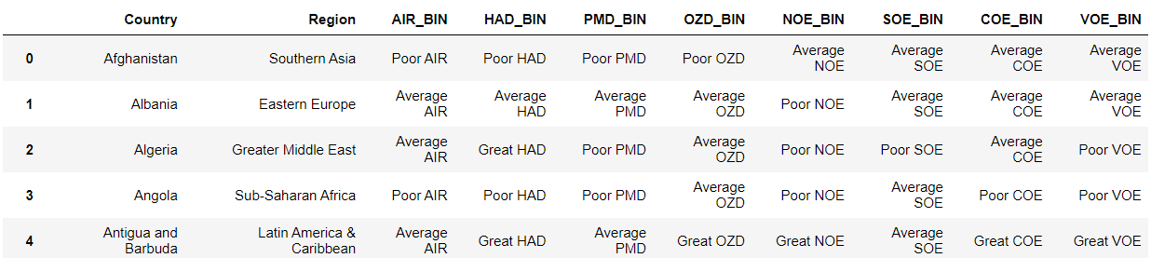
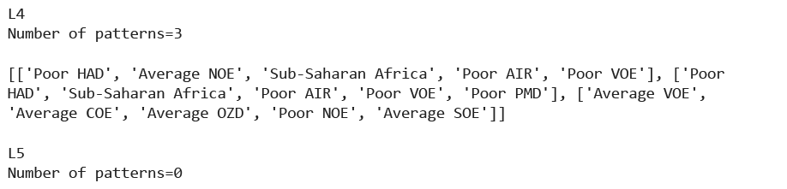
Exploratory Data Analysis
Frequent Pattern Mining
There is a good chance that if a country has Poor VOE, Poor HAD, Poor AIR, Average NOE it lies in Sub-Saharan Africa
If a country has Poor VOE, Poor HAD, Poor AIR, Poor PMD it lies in Sub-Saharan Africa
Apriori
VOE - VOC Exposure
HAD - Household Solid Fuels
NOE - NOx Exposure
PMD - PM2.5 Exposure
Glossary
Notes:
Apriori algorithm is one of the most used frequent pattern mining techniques. Frequent patterns are mined based on regions, air qualities and other factors.
Dataset was converted from numerical scores to binned groups for every attribute.
The Apriori algorithm is easy to understand. The results are intuitive and easy to infer. This algorithm can be efficiently used here as the dataset is not large.
After implementing the algorithm we found out that there is a good chance that if a country has Poor VOE, Poor HAD, Poor AIR, Average NOE it lies in Sub-Saharan Africa. Similarly, if a country has Poor VOE, Poor HAD, Poor AIR, Poor PMD it lies in Sub-Saharan Africa

Slide 12
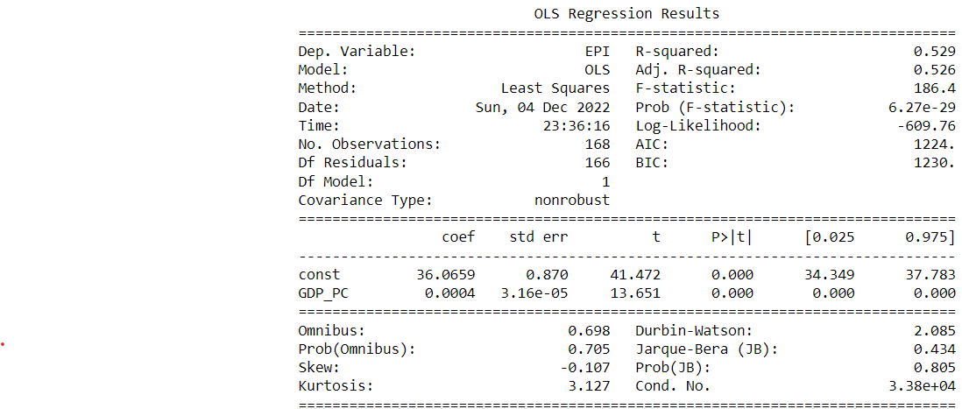
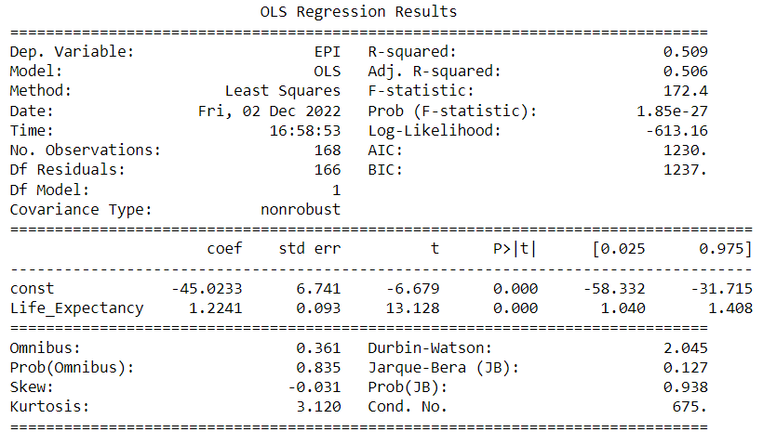
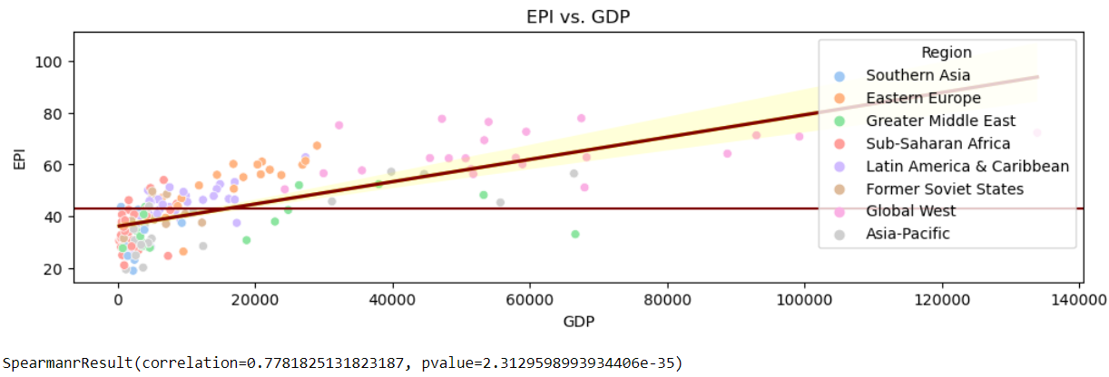
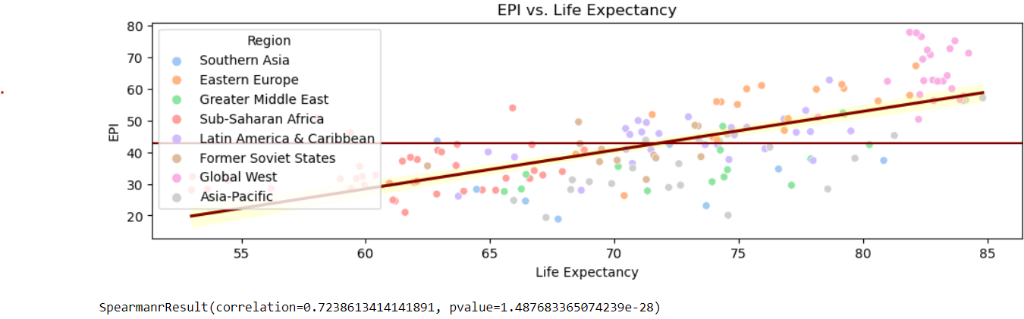
Effects of External Factors on Sustainable Development
EPI vs GDP per capita
EPI vs Life Expectancy
Notes:
Simple linear regression is a model which analyzes one dependent and one independent variable and provides insight about their relationship. Using simple linear regression, we can observe the general relation between external factors and EPI.
A strong positive correlation can be seen for EPI vs GDP per capita [6]. Spearman correlation is 0.778 and the p-value is 2.312e⁻³⁵ also confirms the same.
A good R-squared value of 0.529 can be observed.
A strong positive correlation can be seen for EPI vs Life Expectancy. Spearman correlation is 0.724 and the p-value is 1.487e⁻²⁸ also confirms the same.
A good R-squared value of 0.509 can be observed.

Slide 13
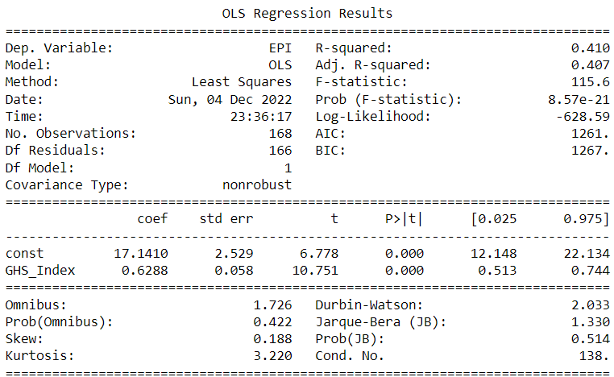
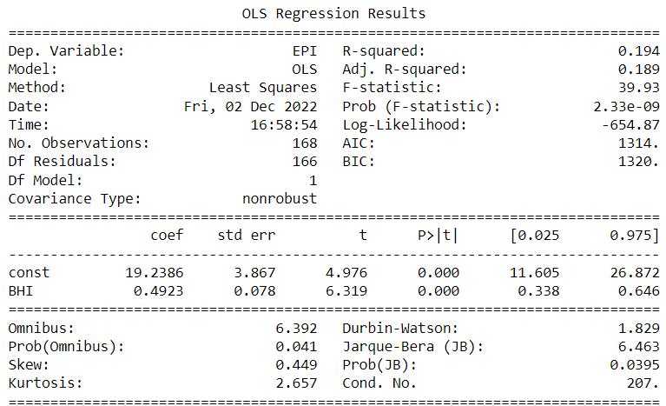
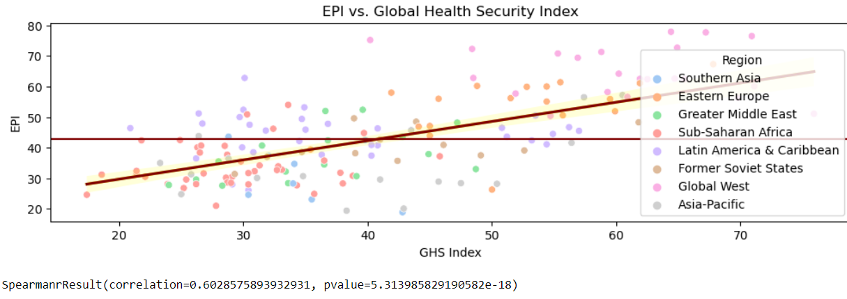
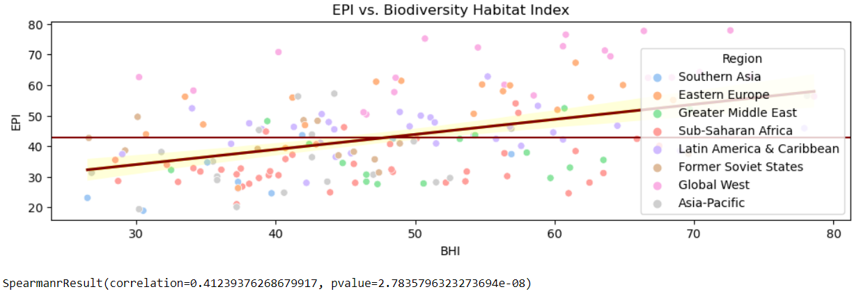
Effects of External Factors on Sustainable Development
EPI vs GHS Index
EPI vs BHI
Notes:
A positive relation can be seen for EPI vs Global Health Security Index. Spearman correlation is 0.602 and the p-value is 5.313e⁻¹⁸ also confirms the same.
A good R-squared value of 0.410 can be observed
A positive relation can be seen for EPI vs Biodiversity Habitat Index. Spearman correlation is 0.412 and the p-value is 2.783e⁻⁰⁸ also confirms the same.
A decent R-squared value of 0.194 can be observed.

Slide 14
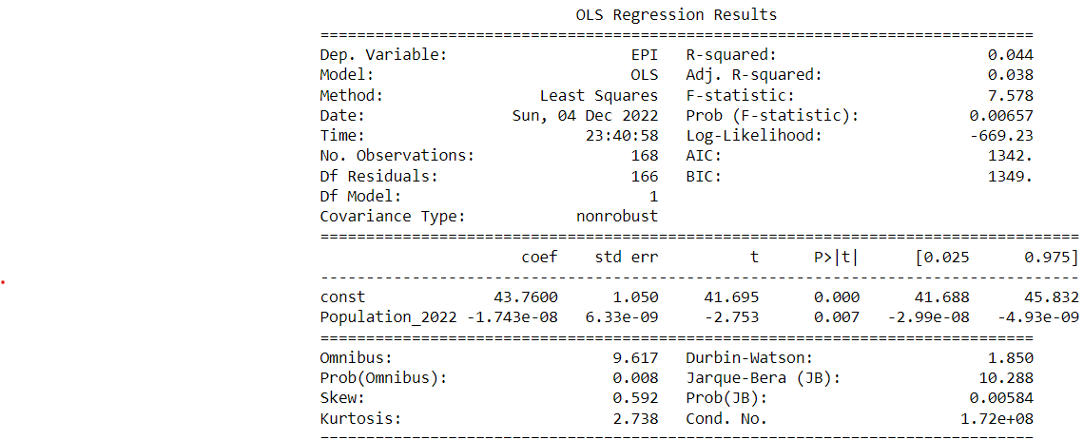
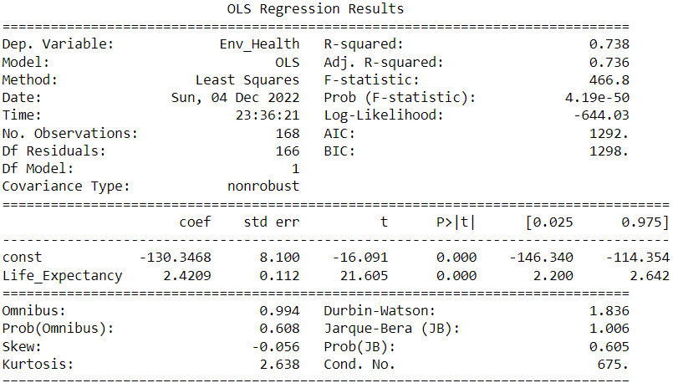
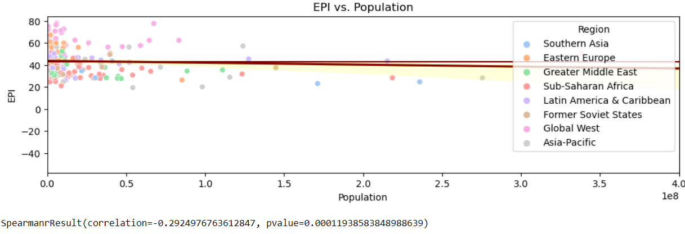
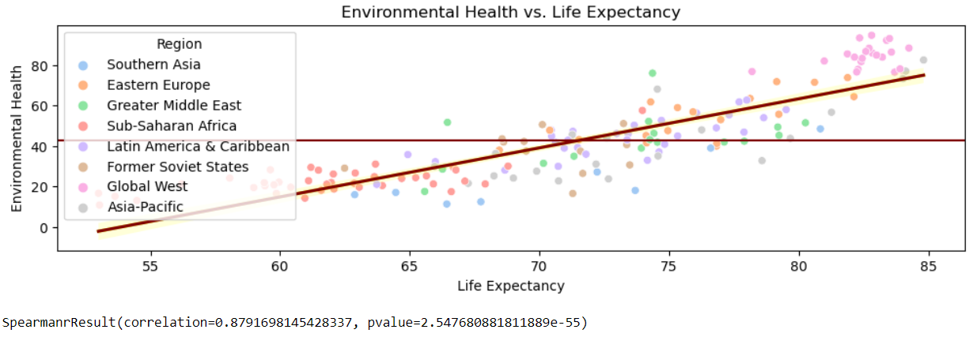
Effects of External Factors on Sustainable Development
EPI vs Population
Environmental Health vs Life Expectancy
Notes:
A negative relation can be seen for EPI vs Population. Spearman correlation is -0.292 and the p-value is 0.0001 also confirms the same
A very low R-squared value of 0.044 can be observed
A strong positive relation can be seen for Environmental Health vs Life Expectancy. Spearman correlation is 0.879 and the p-value is 2.547e⁻⁵⁵ also confirms the same.
A very good R-squared value of 0.738 can be observed.

Slide 15
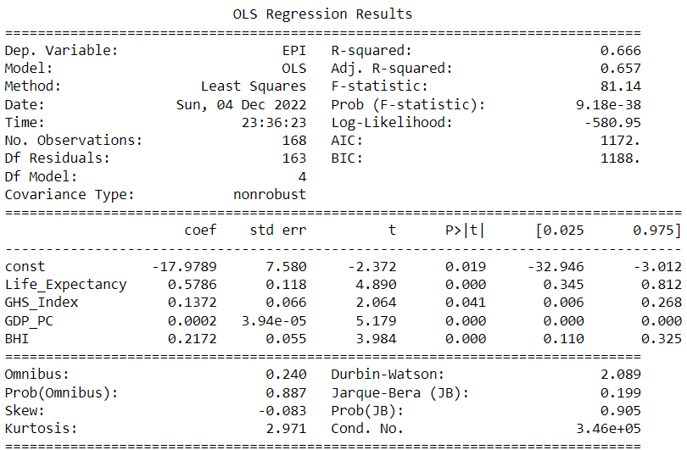
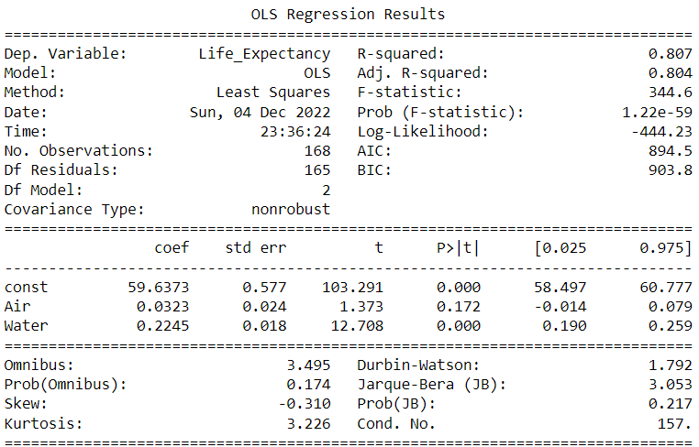
Effects of External Factors on Sustainable Development
Multiple Linear Regression
EPI vs (Life Expectancy, GHS Index, GDP per capita and BHI)
Life Expectancy vs (Air and Water)
Notes:
We will be using several explanatory variables to predict the outcome of a responsible variable.
We will be using our four main external factors namely GDP per capita, Life Expectancy, Global Health Security Index and Biodiversity Health Index to analyze and determine relation with EPI
We observed a very good R-squared value of 0.666 with very small p-values as shown above
It is interesting to observe that Life Expectancy has the highest coefficient 0.5786 which made us analyze the Life expectancy factor further.
A very high R-squared value of 0.807 is observed. Significant coefficient values and very small p-values can be observed.

Slide 16
Methods - Time Series Analysis / Models & Predictions
What do we expect to see?
COVID effect on environmental sustainability
Effect of other factors on environmental sustainability if there is any
Steps
Simple Linear Regression
Time idx ~ EPI
Multiple Linear Regression
Time idx +
Air Quality +
Sanitation & Drinking Water +
Biodiversity & Habitat +
Water Resources ~ EPI
ARIMA
Notes:
Built multiple models to predict the EPI for 2020 and 2022.
We expect to see higher errors in predictions of EPI 2020 which proves COVID had significant effect on environmental sustainability.

Slide 17


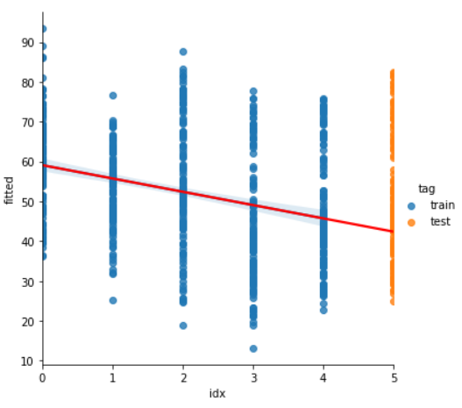

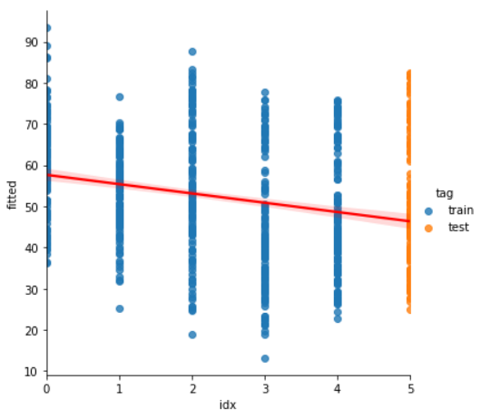
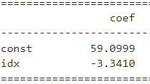
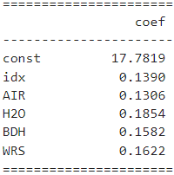


Methods - Time Series Analysis / Models & Predictions
Predict EPI 2020
Simple Linear Regression
All Countries
Multiple Linear Regression
All Countries
benchmark
better
Notes:
Fitted simple linear regression model to predict EPI of 2020.
Fitted multiple linear regression model to predict EPI of 2020.
This model is better than the simple linear regression model.

Slide 18

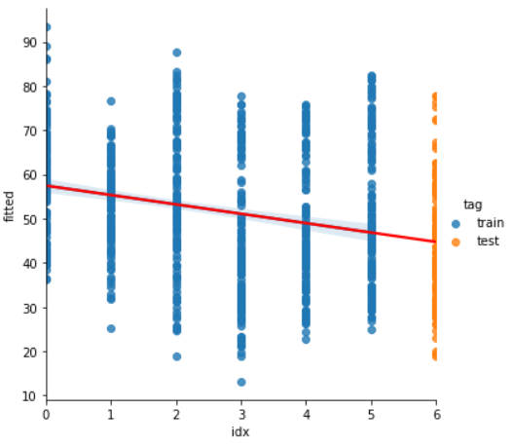

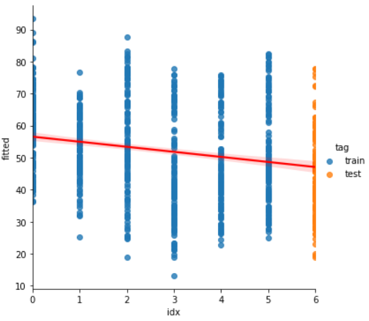
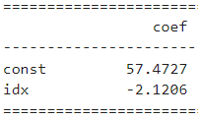
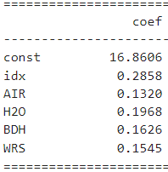


Methods - Time Series Analysis / Models & Predictions
Predict EPI 2022
Simple Linear Regression
All Countries
Multiple Linear Regression
All Countries
could not beat 2020 RMSE
Notes:
Fitted multiple linear regression model to predict EPI of 2022.
Expected to see lower error compared to the model prediction EPI of 2020, since COVID was in 2020 which was an unusual factor.

Slide 19
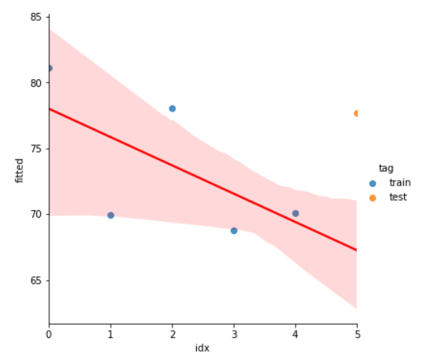

Methods - Time Series Analysis / Models & Predictions
Predict EPI 2020
Multiple Linear Regression
Norway
Notes:
Chose a sample country.
Fitted multiple regression model to predict EPI of 2020.

Slide 20
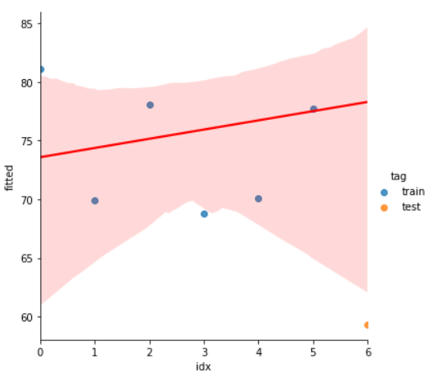

Methods - Time Series Analysis / Models & Predictions
Predict EPI 2022
Multiple Linear Regression
Norway
Notes:
Fitted multiple regression model to predict EPI of 2022. Error is higher than the EPI prediction for 2020 which is not expected. It can be seen that regression models are not capable of trends and fluctuations through time.

Slide 21
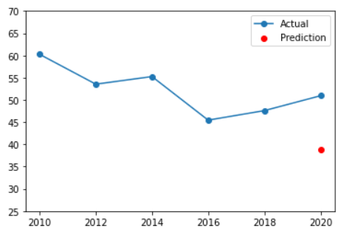
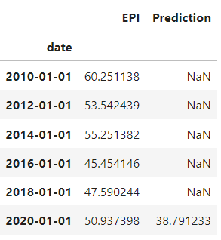
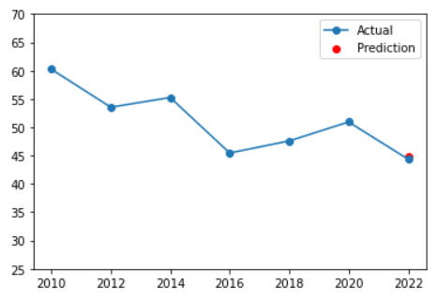
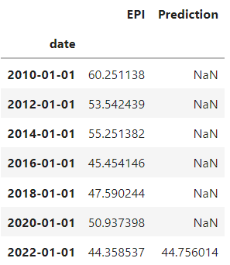


Methods - Time Series Analysis / Models & Predictions
Predict EPI
ARIMA
2020 - All Countries Avg
ARIMA
2022 - All Countries Avg
Higher error in ARIMA for 2020
Notes:
Built ARIMA model using the average of EPI from 2010 to 2018 to predict EPI score of 2020.
Built ARIMA model using the average of EPI from 2010 to 2020 to predict EPI score of 2022.
The error in the model predicting 2020 is much higher which shows that COVID had effect on environmental sustainability.

Slide 22
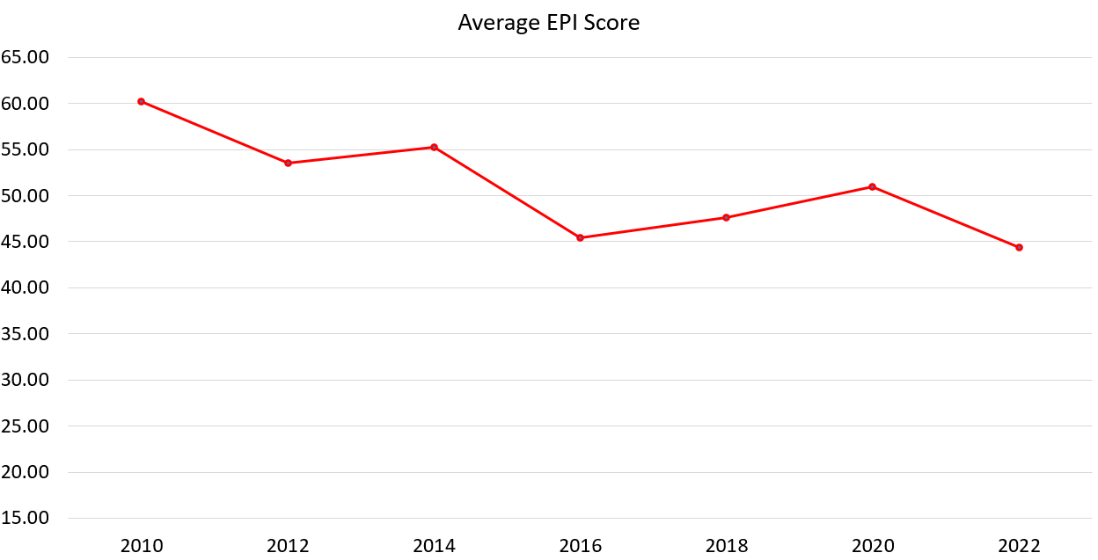
Methods - Time Series Analysis / Models & Predictions
Paris Agreement
ARIMA reflected better decreasing trend of EPI overall through years.
That’s why we had higher RMSE error in 2020.
COVID and Paris Agreement had positive impact on environmental sustainability performance of countries from 2016 to 2020.
However, decreasing trend has continued after COVID has lost its effect.
Covid - Lockdown
The Paris Agreement is a legally binding international treaty on climate change. It was adopted by 196 Parties at COP 21 in Paris
Its goal is to limit global warming to well below 2, preferably to 1.5 degrees Celsius, compared to pre-industrial levels.
To achieve this long-term temperature goal, countries aim to reach global peaking of greenhouse gas emissions as soon as possible to achieve a climate neutral world by mid-century.
Notes:
Talk about trends from 2016 to 2018.
The Paris Agreement, its effects and after covid trends.

Slide 23
Conclusion
Economic and societal setbacks deriving from the COVID pandemic continue to add to the challenge of meeting the sustainability requirements. However, significant improvements in air quality and reductions in greenhouse gas emissions followed early lockdowns and fundamental shifts in economic activities. Policymakers now have a chance to rebuild their economies and societies on a more sustainable basis that keeps the pandemic-induced gains in environmental health and ecosystem vitality – but the latest data suggest that this opportunity is being wasted across most of the world.
Notes:
Same as in the slide.

Slide 24
Future Work and References
We are waiting for Global governance index to be released for 2022, this can be an important external factor to be examined.
Fatma Tektüfekçi & Nilgün Kutay. (2016). The Relationship Between EPI and GDP: An Examination on Developed and Emerging Countries. Journal of Modern Accounting and Auditing, May 2016, Vol. 12, No. 5, 268-276
https://unfccc.int/process-and-meetings/the-paris-agreement/the-paris-agreement
Notes:
Same as in the slide

Slide 25
Thank you
Notes:
Thank you professor for the opportunity and the guidance throughout the semester. Also, thanks to Hanjia and Junyu for their continuous inputs and help.

Slide 26
Additional References
https://medium.com/@josemarcialportilla/using-python-and-auto-arima-to-forecast-seasonal-time-series-90877adff03c
https://alkaline-ml.com/pmdarima/tips_and_tricks.html

